Slide 2
Predictive Maintenance in the Automotive Industry
AUT301
Vishaal Kapoor, Phd
Ben Eiref
Soji Adeshina
Senior SDM
AWS AI
Global Head of Auto & Mobility Solutions
Machine Learning Engineer
AWS AI

Slide 3

Agenda
1. Introduction to Predictive Maintenance
2. Connected Vehicle
3. Predictive Maintenance
4. Anomaly detection
5. Discussion

Slide 4
Introduction to Predictive Maintenance

Slide 5
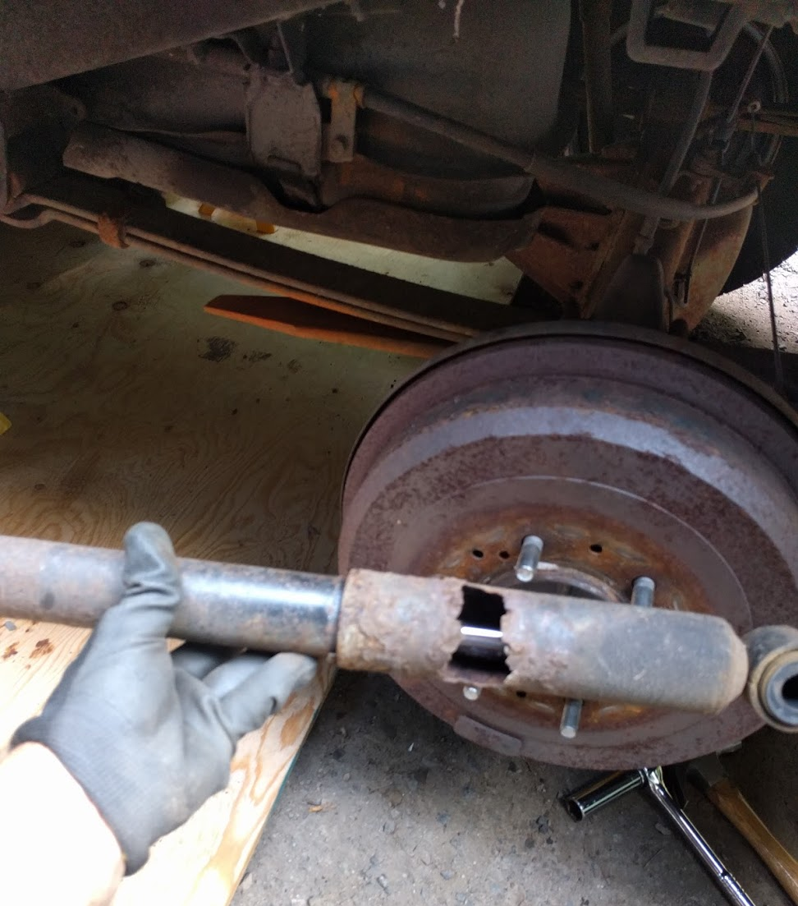
Maintenance: Preventative vs Corrective
Replacing a failing starter vs replacing a dead starter
Replacing a squeaky fan belt vs replacing a broken one
Timely changing of oil vs untimely changing of oil
Replacing worn tires vs replacing a flat tire

Slide 6
Predictive Maintenance
Sensor Data
Model
Time
Maintenance Records
Date | VIN | ECU code | Cause
1/22/2017 | 1234 | P0302 | spark plug
2/4/2016 | 5678 | U0102 | wiring
2/2/2017 | 9012 | C0701 | low coolant
2/29/2018 | 3456 | P1501 | speed sensor
Time
Remaining Useful Life

Slide 7
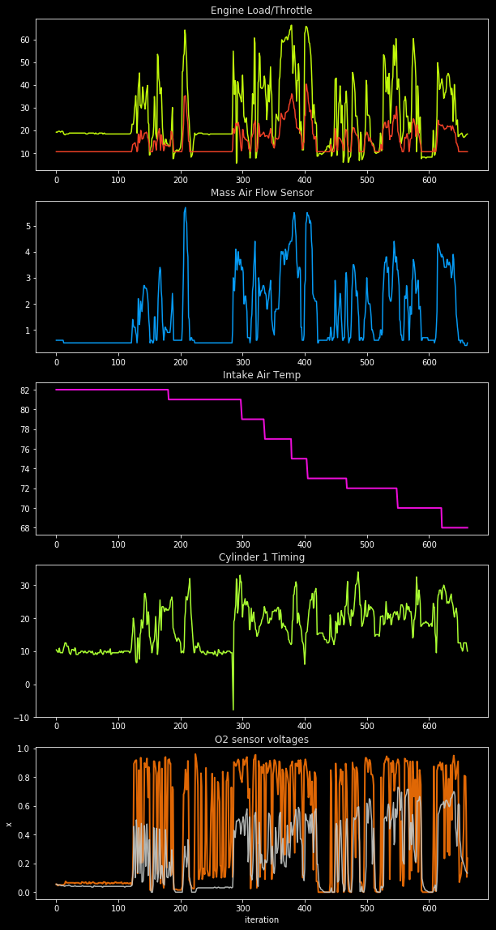
Sensor Data and Maintenance Logs
Correlation with failure (feature selection)
Data quality
Data fidelity
Feature selection
Preprocessing
Coverage
Faulty sensor data
Faulty maintenance logs

Slide 8
1. Connected Vehicle

Slide 9
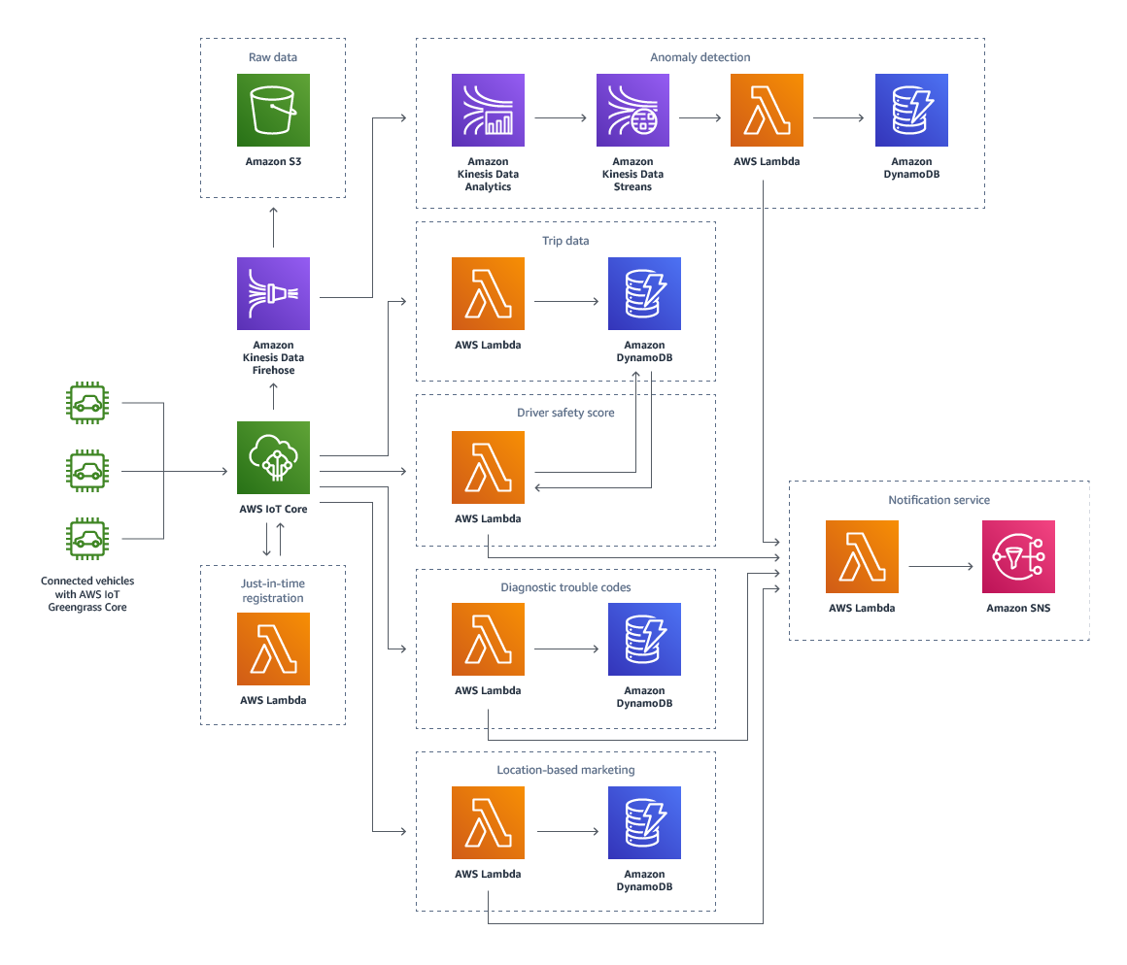
AWS Connected Vehicle Solution

Slide 10
2. Predictive Maintenance

Slide 11
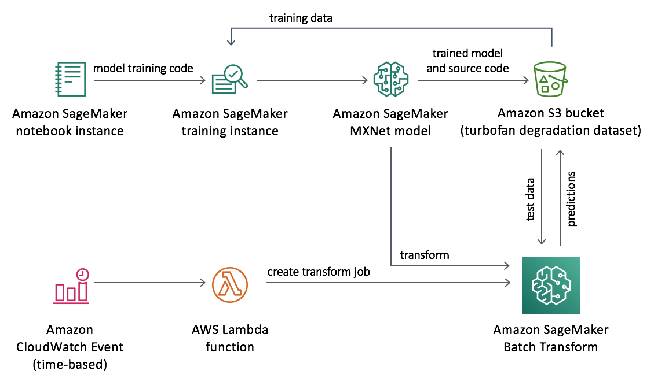
Predictive Maintenance Using Machine Learning

Slide 12
3. Anomaly detection

Slide 13
Chalk-talk

Slide 14
Vishaal Kapoor Ben Eiref
Soji Adeshina
vishaalk@amazon.com
eiref@amazon.com
adesojia@amazon.com

